Slide 1
CSE 230
Computer Organization
Dr. Gamal Fahmy
Lecture 7
Pipelining
© Gamal Fahmy

Slide 2
Pipelining
What is a pipelining ?
Pipelining is an implementation technique in which multiple instructions are overlapped in execution.
Pipelining, a standard feature in RISC processors, is much like an assembly line.
Because the processor works on different steps of the instruction at the same time, more instructions can be executed in a shorter period of time.
© Gamal Fahmy

Slide 3
Sandwich Example
At a Burger King Store
Imagine the following steps are done to sell you a whopper
    Fry the Burger ( 5 min)
    Put it in heated bread (3 min)
    Fill it up with Lattice, Onion, Ketchup….. (1 min)
    Wrap it up in a bag ( 2 min)
    Place it on the cashier tray for your order (3 min)
© Gamal Fahmy

Slide 4

Sandwich
Fry it
Head bread
Ketchup
Wrap it
Tray it
5 min
3 min
1 min
2 min
3 min total = 14 min
© Gamal Fahmy

Slide 5
Sandwich
Suppose 4 big guys went in to get lunch and ordered 4 whoppers with one card
It will take them 14 * 4 =56 min to get their order
If we do pipeline the sandwich process they can enjoy their food in only 22 min
© Gamal Fahmy

Slide 6

Pipelining a Sandwich
Fry it
Head bread
Ketchup
Wrap it
Fry it
Tray it
Head bread
Ketchup
Fry it
Wrap it
Head bread
Tray it
Ketchup
Fry it
Wrap it
Tray it
Head bread
Ketchup
Wrap it
Tray it
© Gamal Fahmy
23 min

Slide 7
Pipelining
Our goal is to increase the throughput
Throughput: number of instructions per a time scale
No two operations to run on the same data-path or the same unit at the same time
RISC architecture allows a lot of pipelining, due its simplicity so overlapping is easy
© Gamal Fahmy

Slide 8
Pipelining
Pipelining is all about increasing the throughput, it includes reducing the clock cycle
If one of the stages of the pipeline is slower, then every thing will wait
Ideally stages should have the same time
If SERIAL data input and output rate is the same, then Pipelining is not useful (it can only reduce the clock cycle)
© Gamal Fahmy

Slide 9
RISC Processor
A RISC processor pipeline operates in much the same way, although the stages in the pipeline are different. While different processors have different numbers of steps, they are basically variations of these five, used in the MIPS R3000 processor
    fetch instructions from memory (IF)
    read registers and decode the instruction (ID)
    execute the instruction or calculate an address (EX)
    access an operand in data memory (MEM)
    write the result into a register (WB)
    These are micro instructions
    May not be efficient for some instructions
© Gamal Fahmy

Slide 10
RISC Processor
Pipe stage
Inst. number | 1 | 2 | 3 | 4 | 5 | 6 | 7 | 8 | 9
1 | IF | ID | EX | MEM | WB
2 |  | IF | ID | EX | MEM | WB
3 |  |  | IF | ID | EX | MEM | WB
4 |  |  |  | IF | ID | EX | MEM | WB
5 |  |  |  |  | IF | ID | EX | MEM | WB
Branch Store ALU
© Gamal Fahmy

Slide 11
Pipelining
Is it that simple, NO IT IS NOT
Ideally we assume that all micro-instructions or instruction steps are independent, this is not always true
Separate instructions should use separate memory registers (separate caches) and separate data paths
In pipelining we either reduce the CPI or reduce the clock cycle time, or BOTH
© Gamal Fahmy

Slide 12
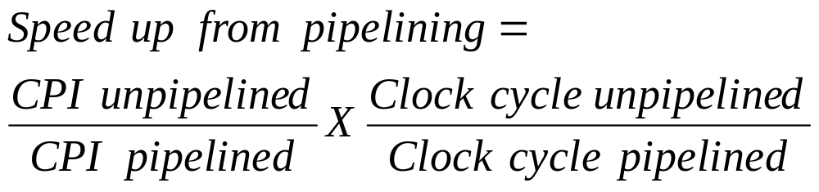
Pipelining Performance
Stalls: they are situations were we can’t start a new micro-instruction every clock cycle
Pipeline depth is the number of stages for an instruction
© Gamal Fahmy

Slide 13
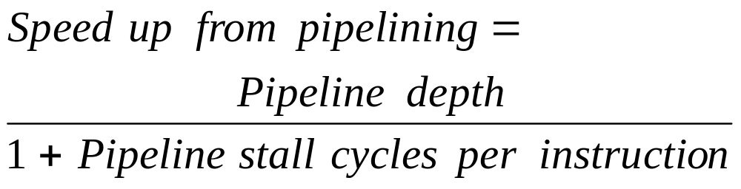
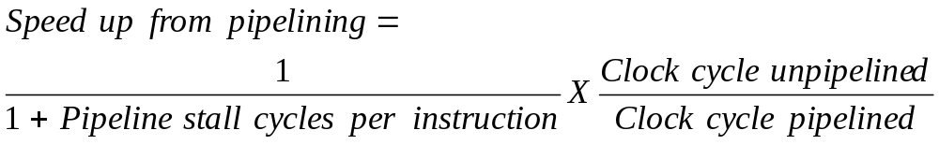
Pipelining Performance
© Gamal Fahmy

Slide 14
Pipelining
If the CPI is the same for both pipelined and un-pipelined processors, memory/data paths will deliver faster= Bigger Bandwidth
Due to hardware interference and data hazards, latches or register are place between successive pipe stages
This will create a slight increase in the execution time for each microinstruction
© Gamal Fahmy

Slide 15
Pipelining
1
2
3
4
5
6
7
8
9
Mem
Reg
ALU
Mem
Reg
Mem
Reg
ALU
Mem
Reg
Mem
Reg
ALU
Mem
Reg
Mem
Reg
ALU
Mem
Reg
Mem
Reg
ALU
Mem
Reg
© Gamal Fahmy

Slide 16
Pipelining
It is about increasing throughput and reducing clock cycle time
    No reduction in execution time for every micro-instruction (as a matter of fact it slightly increases)
    It is different than PARALLEL PROCESSING
    Makes programs run faster
Latency: it is the time it takes to process a single instruction (micro instruction)
      NOT → ADD A,B
Clock period can’t be faster than slowest stage in addition to latch delay
© Gamal Fahmy

Slide 17
Pipelining with latches
1
2
3
4
5
6
7
8
9
Mem
Reg
ALU
Mem
Reg
Mem
Reg
ALU
Mem
Reg
Mem
Reg
ALU
Mem
Reg
Mem
Reg
ALU
Mem
Reg
Mem
Reg
ALU
Mem
Reg
© Gamal Fahmy

Slide 18
Hazards
Structural Hazards
Data Hazards
Control Hazards
Hazards can stall a pipeline, which will degrade the pipelining performance
© Gamal Fahmy

Slide 19
Structural Hazard
Happens when there is a resource conflict
This is typically the case if available hardware is not enough for overlapped instructions
Units are not fully pipelined
Instructions won’t be at a rate of one per clock cycle
Stalls will happen (bubble )
© Gamal Fahmy

Slide 20
RISC Processor
Pipe stage
Inst. number | 1 | 2 | 3 | 4 | 5 | 6 | 7 | 8 | 9 | 10
1 | IF | ID | EX | MEM | WB
2 |  | IF | ID | EX | MEM | WB
3 |  |  | IF | ID | EX | MEM | WB
4 |  |  |  | Stall | IF | ID | EX | MEM | WB
5 |  |  |  |  |  | IF | ID | EX | MEM | WB
© Gamal Fahmy

Slide 21
RISC Processor
Pipe stage
Inst. number | 1 | 2 | 3 | 4 | 5 | 6 | 7 | 8 | 9 | 10
1 | IF | ID | EX | MEM | WB
2 |  | IF | ID | EX | MEM | WB
3 |  |  | IF | ID | EX | MEM | WB
4 |  |  |  | Stall | Stall | IF | ID | EX | MEM | WB
5 |  |  |  |  |  |  | IF | ID | EX | MEM
© Gamal Fahmy

Slide 22
Structural Hazard
Solution:
  Hardware duplication
  Allow stalls to happen, and decrease CPI (usually)
Why would we allow stalls
  Because structural hazards rarely happens, and it is not worth the cost
© Gamal Fahmy

Slide 23
Data Hazards
Has a greater danger than Structural hazards
Happens typically when data gets updated before its intended value is used
Example
  ADD R1,R3
  ADD R2,R3
  Mov R4,R2
© Gamal Fahmy

Slide 24
Data Hazards
Solution
Hold instructions for cycles vertically
© Gamal Fahmy

Slide 25
Data Hazards Solution
1
2
3
4
5
6
7
8
9
Mem
Reg
ALU
Mem
Reg
Mem
Reg
ALU
Mem
Reg
Mem
Reg
ALU
Mem
Reg
Mem
Reg
ALU
Mem
Reg
Mem
Reg
ALU
Mem
Reg
© Gamal Fahmy

Slide 26
RISC Processor
Pipe stage
Inst. number | 1 | 2 | 3 | 4 | 5 | 6 | 7 | 8 | 9 | 10
1 | IF | ID | EX | MEM | WB
2 |  | IF | ID | EX | MEM | WB
3 |  |  | IF | ID | Stall | EXE | MEM | WB
4 |  |  |  |  | Stall | IF | ID | EX | MEM | WB
5 |  |  |  |  |  |  | IF | ID | EX | MEM
© Gamal Fahmy

Slide 27
Control Hazards
Is the most dangerous if happens
Happens typically if the PC gets updated before a Branch or a jump instruction is executed
Solution: allow instructions to proceed as nothing happened, then go backward and reload data and registers
© Gamal Fahmy

Slide 28
Control Hazard
Stall pipeline - The simplest scheme to handle branches is to freeze or flush the pipeline, holding or deleting any instructions after the branch until the branch destination is known.
Advantage: simple both to software and hardware
© Gamal Fahmy

Slide 29
RISC Processor
Pipe stage
Inst. number | 1 | 2 | 3 | 4 | 5 | 6 | 7 | 8 | 9 | 10
1 | IF | ID | EX | MEM | WB
2 |  | IF | ID | EX | MEM | WB
3 |  |  | IF | idle | idle | idle | idle
4 |  |  |  | IF | ID | EX | MEM | WB
5 |  |  |  |  | IF | ID | EX | MEM | WB
© Gamal Fahmy

Slide 30
Control Hazard
Predict taken - An alternative scheme is to predict the branch as taken. As soon as the branch is decoded and the target address is computed, we assume the branch to be taken and begin fetching and executing at the target address. Expensive in time and hardware units
© Gamal Fahmy

Slide 31
Solution
Inst. number | 1 | 2 | 3 | 4 | 5 | 6 | 7 | 8 | 9
1 | IF | ID | EX | WB | MEM
2 |  | IF | IF | IF | ID | EX | WB | MEM
3 |  |  |  |  | IF | ID | EX | WB | MEM
4 |  |  |  |  |  | IF | ID | EX | WB
5 |  |  |  |  |  |  | IF | ID | EX
© Gamal Fahmy

Slide 32
HW Proble
For the following so called GU processor that consists of the following steps (micro-instructions)
    fetch instructions from memory (IF)
    read registers and decode the instruction (ID)
    execute the instruction or calculate an address (EX)
    write the result into a register (WB)
    access an operand in data memory (MEM)
Calculate the value in R2, and R1 at the end of the program, where R1, R2 and R3 are general purpose registers, assume the initial value in R1=5 and R2=8 and R3=5 and data at memory location A=1, if data is needed to be loaded from MDR, assume the next micro-instruction is delayed until data reaches the MDR
ADD R1,A
ADD R2,R1
If R2 >=10 goto AAA
ADD R2,R3
AAA SUB R2,R1
© Gamal Fahmy

